Slide 1
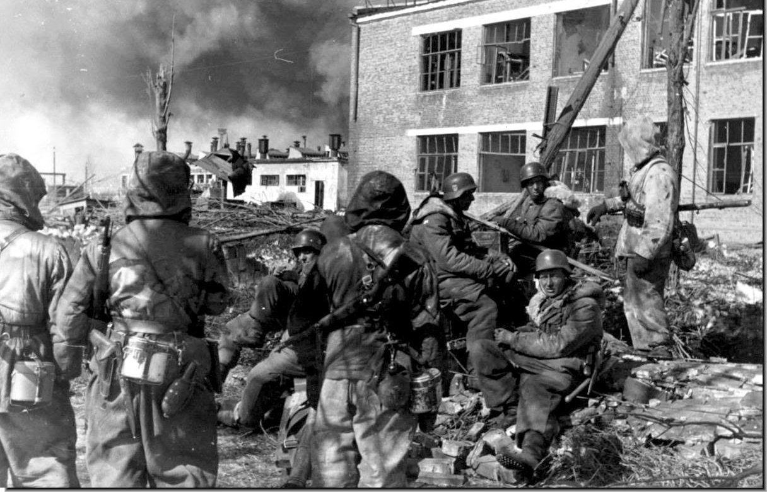
PRESENTATION TITLE
“Quite simply, the Allies were unable to win the reinforcement race" – (#8 p 392)
“But the Germans,
General … The Germans” – General Sosabowski (#5 p 27)
“Model, wary of an airborne attack, had ordered the division’s fighting units [into quick reaction groups] to combat any such eventuality" – (#8 p 42)
COURSE
Presenters: t
Date presented

Slide 2
Declaration
This presentation is free to use
Please acknowledge authorship of it and excerpts to Captains Beatty, Dicker, Egan, Hogan and Rockett

Slide 3
Contents
Intro: 1 of 3
“The Allies were stopped in the south just north of Nijmegen – that is why Arnhem turned out as it did" - (#8 p 392)
Introduction & Conclusion
Capt Dicker
German Situation (September 1944)
Capt Dicker
XXX Corps Advance on Eindhoven & “Hells Highway”
Capt Rockett
Nijmegen
Capt Egan
Oosterbeek & Initial Drop Zones
Capt Hogan
Arnhem
Capt Beatty
Supplementary Material
Order of Battle
2nd SS Panzer Corps (incl. von Tettau)
1st Parachute Army (incl. elements of 15th Army)
Major Kampfgruppen (KGs)
Prolific Authors, Ranks, References, Maps
"Stand still you sods – those bullets cost money" –
2 Para Bn soldier in action at Arnhem Bridge (#5 p 188)
Section headings (Red) are URLs

Slide 4
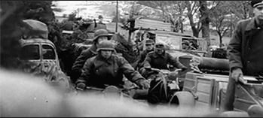
Bottom Line
Intro: 2 of 3
“When the British captured the Nijmegen bridge, the Germans already had the Arnhem bridge in their grasp" – (#8 p 392)
Kampfgruppe
Ad hoc of many different corps and units generally to suit the mission
Mission Command
Critical on the ground and lead to the success of Kampfgruppe
German defence collapses, can they hold out?
“Although badly mauled in the Normandy fighting, the regiment had already been reconstituted and reinserted into combat" – (#8 p 24)
Notes:
Throughout this presentation we hope to convey to you the military miracle that the German Army carried out. All elements of this presentation will focus in on two (2) simple common themes. These are (a) Kampfgruppe and (b) Mission Command.
(a) Kampfgruppe – An Ad Hoc formation of many different corps and units. Generally to suit a particular mission.
The Kampfgruppe was an ad hoc combined arms formation, usually employing a combination of tanks, infantry, and artillery (including anti-tank) elements, generally organised for a particular task or operation.
(b) Mission Command. The German General Staff were happy to give a geographical region to a unit and a very simple Commanders Intent. It was then happy to allow the commander on the ground to have full mission command. Dealing with a mix of ages, skills and corps it is vital that the leader on the ground is given the maximum possible power and responsibility that he can to help him command his troops.
Presentation Flow
Geographical Analysis
Focusing on the actions and counteractions of the Germans.

Slide 5
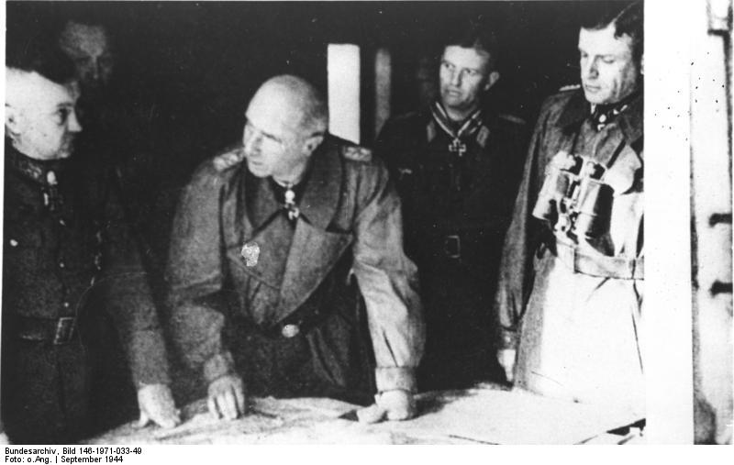
Arnhem
Arnhem: 1 of 11
“My mission was to block the threat in the south long enough to enable 9SS to settle with the British Division in Oosterbeek-Arnhem" – (#8 p 162)
OF 9 Student
IMAGE
OF 3
Knaust
OF 10
Model
OF 6
Harmel
OF 8
Bittrich
“The taking and securing of Arnhem bridge is of decisive importance" – (#5 p107)
“First British Airborne was about to leap into a hornets’ nest “– (#8 p 44)
Return to Contents
II SS Corps “had been specifically trained for an anti-airborne role" – (8 p 42)

Slide 6
Forces IVO Arnhem
Arnhem: 4 of 11
“were reluctant to hand over weapons and equipment when the situation could still unpredictably change" – (#8 p 41)
Bittrich’s 2nd SS Panzer Corps (#14; #5 pp 49-50; #8 pp 38-44)
Hohenstaufen & Frundsberg divisions
7000 all ranks (#8 p 44)
Panzer grenadier & recce battalions were a “significant” force
DESTROYED during rear-guard actions from Normandy (20%-30% of original strength)
No modern tanks
Christiansen’s Wehrmacht Netherlands comprised logistical and training depots
Constituted ‘Division’ (KG) von Tettau
Included SS guard, Luftwaffe, Kriegsmarine, & V2 rocket ‘soldiers’
Perhaps had a strength of 5000 (#5; #8; #9; #12; #14; #20)
No formal preparations for a para invasion
2 SS Pz Corps trained for an anti-airborne role
9th SS Hohenstaufen was closest div to Arnhem
Formed quick reaction companies in anticipation of an Allied attack
19 “Alarmenheiten” in 12 locations (max 15km or 2 hours from any Allied LZ) (#8 p 42)
Total force IVO Arnhem & Oosterbeek perhaps 10000 (#8 pp 57-64)
40% of this force were genuine combat soldiers
Beginning to defend the Fatherland
Mission Command & strict discipline
Germans knew the 3rd Reich had ‘burned its bridges’ & had to fight

Slide 7
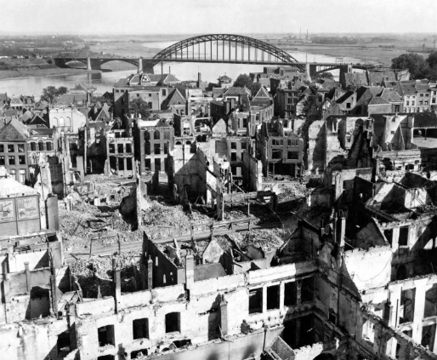
Conclusion
Eastwards: 1 of X
“The retreat from France was the first time I had ever seen demoralised German units" – (#5 p 20)
“It is with personal pride that I regard this German victory, because it was achieved not by regular units, but by railway workers, Arbeitsdienst and Luftwaffe personnel as well, who have never been trained for infantry work and were actually unsuitable for house-to-house fighting" – Standartenführer Harzer (Col OF5) (#8 p 388)
"It never snows in September" - German soldier on seeing the airborne landings (#8 preface)
Return to Contents

Slide 8
Conclusion
“The regiment at this point in time had no uniform issue […] and practically no weapons" – (#8 p 23)
Kampfgruppen
Mission Command
Beaten, broken and demoralised Germans reform and hold the line
Was to be the last German victory in WWII
“Formations were flung into action, whatever there training state, to buy time” (#8 p23)
Notes:
German Success:
Two key elements, that stand out above all others and are critical n ensuring the German success.
They are the utilisation of Ad Hoc units as they exist are can be formed on the ground through the utilisation of Kampfgruppe. You will note these were involved in each and every of the geographical battle analysis that each presenter has offered.
Part of, linked to the use of Kampfgruppe. The following and utilisation of mission command. That due to the situation, it doesn’t allow for the deliberate planning and operations. Doesn’t allow for the use of coherent and fully formed military units. That every commander at every level can operate using his own initiate to support the commanders intent. Operating as best as he can given the circumstances.
These two key characteristics under pinned the German success in Operation Market Garden.
As Kershaw said “Improvisation and astoundingly accurate staff work enabled the German defence to form”
“Formations were flung into action, whatever there training state, to buy time”
QUESTIONS

Slide 9
Major References
References: 1 of 1
Topic
number: “reference title” – author (publisher, year)
10 SS Regt
1: http://www.pegasusarchive.org/arnhem/order_2SS.htm
2: https://www.marketgarden.com/2010/UK/statistics/statis8.html
11: “The 10th SS-Panzer-Division Frundsberg” - R. Michaelis (Schiffer Publishing Ltd, 2008)
17: "http://www.stengerhistorica.com/FromthePress/InEhrfurchtdieFahnenSenken/index.htm" - actions during Operation Market Garden
19: "Panzers East and West: The German 10th SS Panzer Division from the Eastern Front to Normandy" - D. Stenger (Stackpole Books, 2017)
9 SS Regt
3: https://www.marketgarden.com/2010/UK/statistics/statis8.html#assault%20280
4: https://www.marketgarden.com/2010/UK/statistics/statis8.html#panzer%2016
6: https://www.marketgarden.com/2010/UK/statistics/statis8.html#assault%20280
7: https://www.feldgrau.net/forum/viewtopic.php?t=30125
10: “Hohenstaufen: The 9th Ss Panzer Division (Spearhead S.)” – M. Sharpe (Ian Allen Publishing, 2006)
15th Army
13: https://usacac.army.mil/CAC2/CGSC/CARL/nafziger/939GXXN.PDF - ORBAT
Arnhem
15: “Operation market garden: the battle for Arnhem” – B. K. Hoyer The Engineer, 2008)
18: http://mijngelderlandmedia.azureedge.net/2121/18-john-frostbrug_en.pdf - Arnhem Bridge
20: “The Battle of Arnhem” – C. Bauer (Hodder and Stoughton, 1966)
General
5: “Arnhem, the Battle for the Bridges” – A. Beevor (Viking, 2018)
8: “It Never Snows in September: The German View of Market-Garden and the Battle of Arnhem, September 1944” – R. Kershaw (Ian Allen Publishing, 2007)
9: “Sons of the Reich: The History of II SS Panzer Corps” – M. Reynolds (Spellmount Publishers Ltd ,2001)
12: http://www.antonybeevor.com/order-of-battle-operation-market-garden/ - ORBAT
14: https://www.axishistory.com/index.php?id=2084 – ORBAT Army Group B
16: "The Evolution of Command Approach“ – K. G. Stewart, paper presented at the International Command and Control Research and Technology Symposium, June 2010, p. 10
21: “The Struggle for Europe” – C. Wilmot (Wordsworth Editions Ltd., 1997)
22: “A Magnificent Disaster: The Failure of the Market Garden, The Arnhem” – D. Bennett (Casemate, 2008)
Return to Contents

Slide 10
Managing Ethical Boundaries in the IDF

Slide 11
Classification: Unclassified
Distribution: Internal
Presenter: [Your Name]

Slide 12
Purpose and Context
Framework and Constraints
Analysis
Bottom Line Up Front (BLUF)
Conclusions
References

Slide 13
Public trust is the decisive terrain.
Strategic communication must be ethical, consistent, and evidence-led.
Guardrails prevent mission creep and reputational harm.

Slide 15
Adopt a governance model for messaging.
Continuously assess public sentiment and adapt.
Train leaders in ethical communication.

Slide 16
Doctrine A: ...
Policy B: ...
Study C: ...

Slide 17
1. Purpose and Context

Slide 18
Operating environment
Media landscape
Disinformation vectors

Slide 19
2. Framework and Constraints

Slide 20
Constraints
OPSEC
Privacy
Political neutrality

